Slide 1


MSC3182
SOCIAL ENTREPRENEURSHIP
Lesson 3
Early adopter

Slide 2
EARLY ADOPTORS
A person who starts using a product or technology as soon as it becomes available.
The early adopters form 13.5% of any customer base.
Therefore, it is important to identify and qualify them right at the beginning.
Simply put, early adopters are customers who:
Have the problem you are trying to solve
Know that they have the problem
Are actively seeking a solution

Slide 3
Customer adoption patterns

Slide 4

INNOVATORS
First customers who try a new product/service.
Risk-takers who would like to explore and are ok even if the product/service does not meet their expectations.
According to Larry Marine the UI expert,
“It is far better to adopt the technology to the user than to force the user to adapt to the technology.”

Slide 5
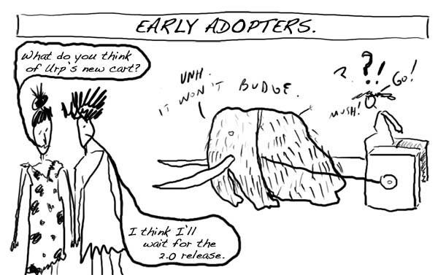
EARLY ADOPTORS
The most influential customers and are very active on social media.
They are moderate risk-takers but have a high stake in providing feedback on the products/services.
They ask many questions for clarification before making a buying decision.

Slide 6
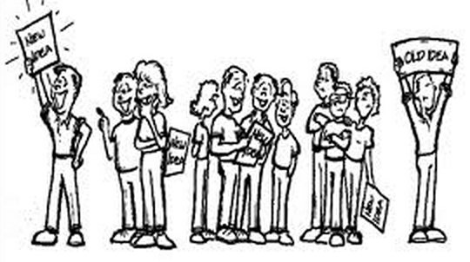
EARLY MAJORITY
Early Majority are wise spenders.
They often consult with the early adopters before making buying decisions.
Reasonable risk-takers and have average social status.

Slide 7
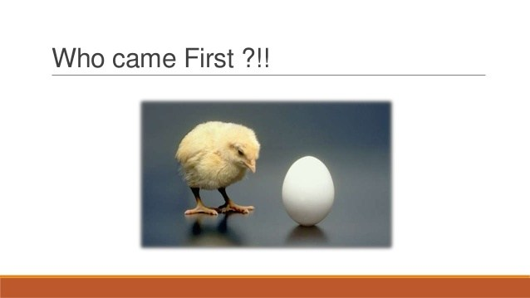
LATE MAJORITY
Late Majority are the risk-averse people,
Comparatively low in social status and
Basically from the low-income groups.
They evaluate various pros and cons before taking a buying decision.

Slide 8
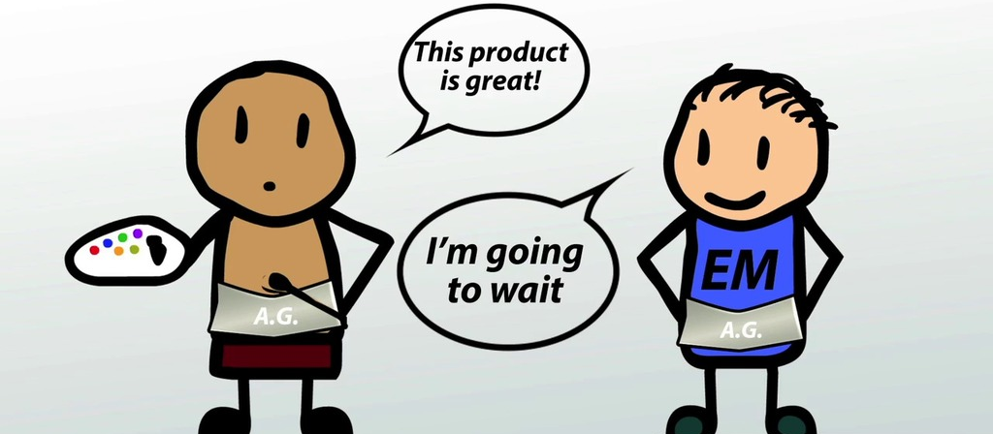
LAGGARDS
Last to adopt a product/service, especially when it is in its declining phase.
Risk-averse people and not open to change.
Traditional buyers who consult only within close connections when taking a buying decision.

Slide 9
How do customer adoption patterns help you?
Once entrepreneurs understand the product/service adoption patterns of people, their marketing strategies can be changed accordingly to have a bigger outreach.
Innovators can be the best bet to be targeted first to gain support.
Early adopters can be targeted next.
The early majority often follow the early adopters
Late majority people can be targeted once the venture has established
Laggards are pretty laid back in taking buying decisions.

Slide 10
Further Reading
Student Handout
Early Adopters

